Slide 1
The Co-op Future Leaders Index 2013
Capturing the opinions and aspirations of Australia’s
young minds
Presented by
Greg Smith CMO
November 2013

Slide 2
Objectives
Integral to transformation journey
Demonstrates that Co-op lives and breathes the needs and opinions of the nation’s future leaders
55 year old retailer just waking up - innovation and thought leadership
Create a conversation
Enables the Co-op to connect with all stakeholders – media, academic, supplier, corporate, government
Part of member reactivation program
First of its kind
Co-op now positioned as thought leader – 3 White Papers:
1: Employment and Politics (May)
2: Lifestyle and Technology (July)
3: Education and Australia (October)
Methodology
24 minute online survey with Co-op members aged 17-29 years old
2,053 responses in total from Co-op member database
Detailed coverage by age, gender, member group and location

Slide 3
Research Objectives
Australia 2020
Attitude to environment
Involvement in politics
Employment opportunities
Life plans post uni
Attitudes to property ownership
Coolest brands now
Brands to make the future
Inspirational people
Social media and technology use
Income and spend
Post grad salary expectations

Slide 4
A land of entrepreneurs…

Slide 5
Employment
The entrepreneurial and independent generation
40% planning to start their own business in the future
60% stated universities don’t do enough to help students learn how to run a business
Pessimism about immediate employment prospects
No confidence in major employer brands
Global downturn reduced overseas and local Australian employment opportunities
Over 50% believe prospects for employment in chosen field after university not strong
Prolong jobs – More study - uni safe haven
Over 40% (over 50% int. students) staying on at university due to low job prospects
Almost 70% planning on a postgraduate course or Masters at some point in future.
Sensible and realistic salary expectations
Overall salary expectation of $50,700 soon after graduating.
Most remain very confident degrees viable in job market for career longer term

Slide 6
Politics
Political interest tepid
68% do not rank politics highly as an interest
55% not knowledgeable when it comes to politics
Same, Same
44% see little difference between the main parties
30% don’t care who gets in at next election
Voting preferences
34% Lib; 29% ALP; 22% Greens
Preferences variable according to study discipline
But if in doubt - vote Green!

Slide 7
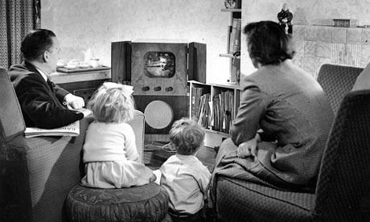
Introducing - Generation Sensible – back to the 50’s…

Slide 8
Life Plans and Property Ownership
Generation Sensible
Over 90% plan to buy a house/flat/apartment (in @ 5-6 years time)
Almost 90% plan on getting married (in @ 6-7 years time)
Almost 90% plan on having a family (in @ 7-8 years time)
Career break, just before the house purchase, marriage, family…
80% plan on taking career break- (travel overseas for > 3 months)
Travel in about 4-5 years time, just before they start to settle down!
It’s all in the plan…
Realistic about lower outright home ownership going forward
80% stated because of high cost of houses, many never own their own home outright
70% believe that home ownership is as important to them as it was to their parents
80% will continue to buy despite prices rising in next 5 years
Resigned to outright home ownership may never eventuate but a strong desire to buy

Slide 9
Brands and Inspiration
Apple deemed the coolest brand… by far
Over 40% stated Apple is the coolest brand spontaneously
Next were (in rank order) Samsung, Nike, Google, Sony, Adidas, Coke, Vans,
Apple more popular with the ladies, Samsung with the boys
Social Media a fad?
Google, YouTube, Samsung, Apple and ebay deemed by Future Leaders as most likely to be even more popular in 2020
But MySpace, Vodafone, Pinterest, Instagram, Pepsi, Telstra and Qantas predicted to become much less popular
Who inspires me?... Mum!...
Family, particularly mum, plays a very strong role
Consistent with Future Leaders’ mature and grounded life plans
…and the 44th president of the United States
Barack Obama clearly most inspiring business person or political leader
Bill Gates, Dick Smith, Richard Branson, Mark Zuckerberg also popular

Slide 10
Social Media and Technology
Facebook facing it’s own cliff
65% state they are very bored with Facebook
29% agreed they could see themselves using Facebook more in the next few years
56% stated that Social Media is taking up too much of their day
Phenomenal technology use and ‘screen time’
Phones used for 2 hours 7 mins per day
Tablets used for 1 hour 43 mins per day
Laptops used for 4 hours 8 min per day
Desktops used for 4 hours 20 mins per day
And there is variation by gender and age
Younger girls using phones for longer than other FLs
Younger FLs using tablets and laptops for longer than other FLs
Older males using desktops for longer than other FLs
And there is inappropriate use…
FLs admit to using technology at times when they really shouldn’t
66% admit to often using their phone/tablet or computer when they should be sleeping

Slide 11
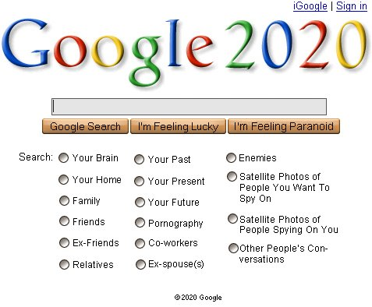
The Future, Environment and Student Wallet

Slide 12
Australia Today and Tomorrow
Positive about Australia in 2020
Future Leaders unquestionably favourable about Australia in 2020
50% believe it will be a better place to live and just 25% saying worse in 2020
Dark clouds on the 2020 horizon
Unaffordable housing will be the # 1 issue in 2020
Aging population 2nd biggest issue (they’ll inherit the problem!)
The environment 3rd biggest issue, falling employment opportunities/declining economy 4th and lack of space/population growth 5th biggest issue affecting Australia in 2020
Australia key player in Asia, but not globally
70% believe Australia has significant influence in the Asia region
60% seeing Australia having little influence globally
Cultural cringe?
Foreign johnnies?
50% believe Australia is still culturally behind much of the rest of the developed world
70% agree there are too many foreign companies buying up Australian companies

Slide 13
The Environment
Most believe global warming is happening
Almost 90%state they believe global warming is happening
40% agreed it’s the Government’s job to motivate not individual’s
Findings suggest political parties need to better address concerns about environment
Also show leadership in providing the guidance and solutions desired
Feel limited about what they can do
70% admit to feeling limited in what they can personally do to reduce climate change
Only 25% stated they felt extremely or very well informed about global warming
Significant opportunity to equip Future Leaders with the necessary knowledge and tools

Slide 14
Income and Spend
Employment now the norm
65% of all Future Leaders are working to some extent
54% of year 1 and 2 and 61% of years 3 and 4 are working to support themselves
Three quarters of income comes from paid work
Estimated average total monthly income: $1,780 of which $1,355 or ¾ comes from paid work
Average spent on rent/mortgage: $369 (21% of total)
Food $183 (10%), Transport $109 (6%), Eating Out (5%), Bills (4%)
They are saving too!
They are likely to be saving as well
For the long travelling holiday, the house, the wedding and the kids?
Of course, they are Generation S!

Slide 15
The Co-op Future Leaders Index 2013
Thank you…
www.coop.com.au

