Slide 1
Agriculture COVID toolkit
12 October 2020

Slide 2
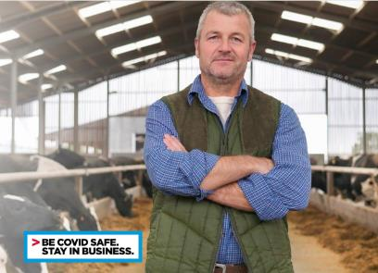
Purpose of this toolkit
COVID-19 has had a significant impact on the agricultural industry and the communities that are supported by the sector.
To help, this toolkit contains adaptable communication materials about:
Being COVID Safe →
Mentally Healthy Workplaces →
Changes to border permits for agricultural workers →
Social tiles →
Workspace signage →
Indigenous community content →
Getting up-to-date information during this time of rapid change can be difficult. If you have any questions or need additional information, please visit nsw.gov.au or contact Service NSW on 13 77 88.

Slide 3
Being COVID Safe

Slide 4
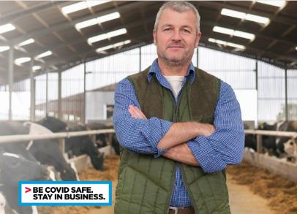
Being COVID Safe: Register as a COVID Safe business
Register as a COVID Safe business
Registering as a COVID Safe Business is the best way to reassure customers and employees that steps have been taken to keep them safe.
Find the safety plans for agriculture at nsw.gov.au – there is one plan for border workers and one for all other agriculture businesses.
Once a plan is in place you can register as a COVID Safe business. You will have access to a digital COVID-Safe badge, downloadable posters on safety and hygiene, a QR code for check-in as well as reports on how customers rate the businesses’ safety.
Together with help from businesses and the public NSW will get through this and return to a stronger and economically more vibrant community again.
For more information: nsw.gov.au
If you need business support, contact nsw.gov.au or 13 77 88.

Slide 5
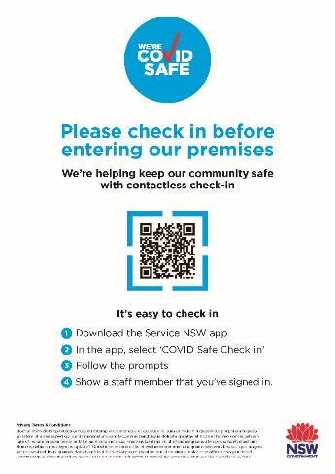
Being COVID Safe: Check-in
Example of a QR code
For many businesses is it is mandatory to keep the details of people who have visited their workplace
Even if it’s not mandatory for your agri-business, it’s strongly recommended because it will help you and NSW Health manage contact-tracing should it ever be needed
The method used to record contact details is up to the business owner, provided all the requirements can be fulfilled
Businesses should consider strategies to ensure all staff and patrons register accurate information when they have been on the premises
QR code check in is strongly encouraged as a contactless, hygienic method (no need to share a pen) and personal data is out of view
Data should be stored securely for 28 days before being deleted
A free Service NSW QR code check in option is available for businesses and organisations that register as COVID Safe
The customer is prompted to download and install the Service NSW app if needed
The app will then verify the customer and register them as being at the business
The app manages all data securely

Slide 6
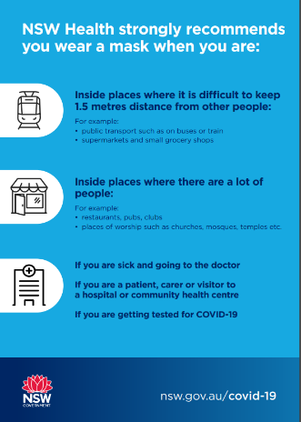
Being COVID Safe: at work poster
Not all agri-businesses are on-farm – a poster is useful to remind employees and customers of the steps they can take to stay safe.
You’ll receive access to a range of posters when you register.
Link to download

Slide 7
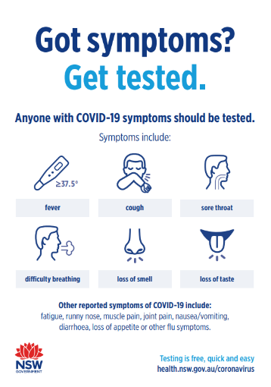
Being COVID Safe: Resources and guidance
Physical distancing
Premises should consider how they can allow workers, customers or others (e.g. contractors) to practice physical distancing in their COVID-19 Safety Plans.
More information on physical distancing
Symptoms and testing
Anyone feeling unwell, even with the mildest of symptoms should get tested immediately, even if they have been tested before and stay home till they have the results.
The main symptoms of COVID-19 are fever, cough, sore/scratchy throat, shortness of breath, loss of smell, loss of taste and runny nose.
Other symptoms include joint pain, muscle pain, headache, diarrhoea, nausea/vomiting and loss of appetite.
Testing is available at pop-up or drive through clinics, your GP, a COVID-19 clinic or hospital.
Find your nearest testing clinic or call the National Coronavirus Health Information Line for information about COVID-19 on 1800 020 080 (24-hour help line)
For free help in your language call 13 14 50
Self-isolation rules
You must self-isolate if you have:
been tested for COVID-19 and are awaiting results
been diagnosed with COVID-19
are suspected of having COVID-19
had close contact with a confirmed case of COVID-19
been in Victoria within the past 14 days and you are entering NSW
have returned from overseas and are exempt from hotel quarantine
more information on self-isolation rules
Link to download
See also a range of other posters to download

Slide 8
Being COVID Safe: Resources and guidance
Education and communication
provide staff with information and training on COVID-19
use visual reminders and signage to remind everyone of their responsibilities such as floor markings
Physical distancing
monitor and control the number of workers in all relevant areas (including accommodation when provided) to maintain 1.5 meter rule where practicable and safe hygiene practices
Workplace facilities
configure communal areas such as lunch rooms to maintain appropriate physical distancing
if your business accommodates seasonal workers, ensure accommodation facilities are cross-checked with the COVID-19 Safety Plan for Hotels and Accommodation
Minimise additional exposure
by implementing contactless farm delivery where practicable and minimise sharing of transport
stagger start and finish times or consider discrete shifts of staff
You’ll receive access to a range of posters when you register.

Slide 9
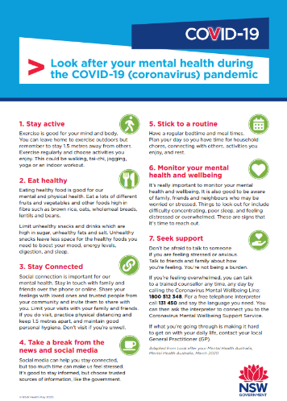
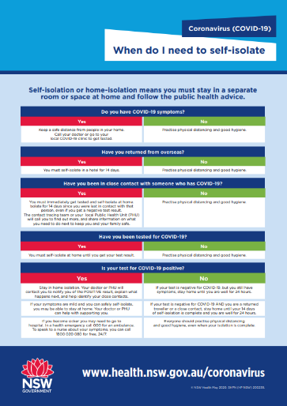
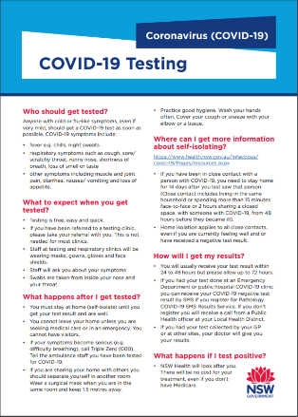
Being COVID Safe: Resources and guidance
Link to download
Link to download
Link to download

Slide 10
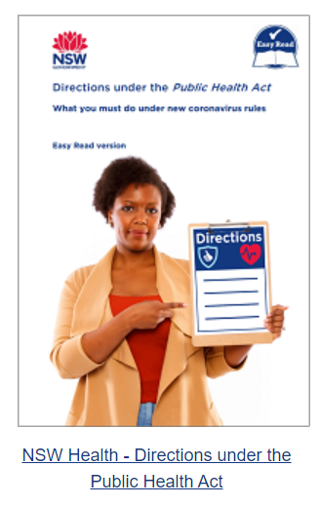
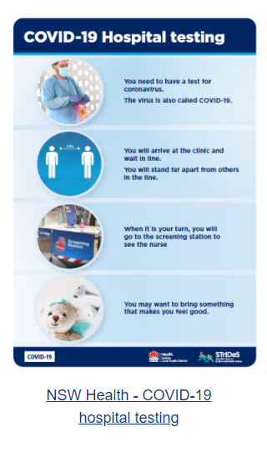
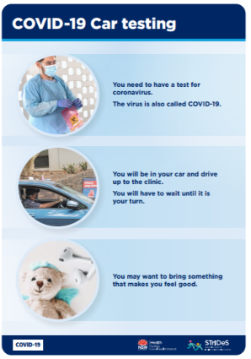
Being COVID Safe: Resources and guidance – easy English

Slide 11
Being COVID Safe: Resources and guidance
Useful links:
NSW.gov.au COVID-19 information
Register as a COVID Safe business - agriculture
Agri Border permits
Find a seasonal job – Help harvest NSW
Translated content – various languages
General COVID Safe resource toolkit
Health resource library

Slide 12
Mentally Healthy Workplaces

Slide 13
Mentally healthy workplaces: Example newsletter / website copy
Supporting mentally healthy workplaces in the COVID-19 pandemic
2020 has been a challenging year. It has changed the way we live and work.
The NSW Government wants to know how COVID-19 has affected mental health in NSW workplaces. It wants your feedback to understand the issues workers are facing and how businesses have been affected. What you tell us will help inform policy including the NSW Government’s mentally healthy workplaces strategy which is currently under review. Have your say by visiting haveyoursay.nsw.gov.au/mentally-healthy-workplaces
Another way the NSW Government is supporting businesses to get back to work and help the economy on the road to recovery is by providing free programs and support to help create mentally healthy workplaces.
If you’re a business with fewer than 200 employees, you can access free online programs including training developed and delivered by a clinical psychologist from Black Dog Institute. You can learn how to recognise the warning signs of mental ill health through the Your mental health at work training or support your team by accessing the Managing for team wellbeing training. There are different delivery modes for you to choose from.
As the business owner, you can access work health and safety advice direct from an organisational psychologist at Assure programs.
We know that the road to recovery will not be easy. However, together with help from businesses and the rural community NSW will come through this. We can be a stronger and economically more vibrant community again. Visit COVID-19 recovery and Mental health at work for more information and resources.
nsw.gov.au

Slide 14
Mentally healthy workplaces: resources and guidance for mental health
Link to download
Link to download

Slide 15
Changes to cross-border agricultural worker permits

Slide 16
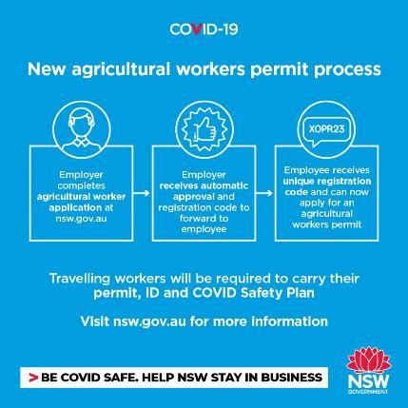
Changes to cross-border agricultural worker permits: newsletter / email / website copy and visual
Border crossings will be easier for agriculture workers
It has became simpler for a wider range of agricultural workers to gain a permit to cross the NSW-VIC border.
From 25 September the simplified approval system makes it easier for farmers who need to hire employees across the two states for the harvest, including seasonal workers.
Once an agricultural worker has their permit, they can travel across the border to work. However, they will need to carry with them:
The new Agricultural Workers Permit
Proof of ID (e.g. driver’s licence or passport)
A valid agriculture COVID Safety Plan
Documentary evidence that they meet the permit criteria, signed by the head of their organisation or, if self-employed, the person for whom the activity is being performed.
As part of their COVID Safety plan, travelling workers need to keep records of their movements and contacts, and details of accommodation. They are also required to use Personal Protective Equipment (PPE) as appropriate.
Permit process
Agriculture workers previously applied for a Critical Service Workers Permit but will now apply for a new agriculture workers permit.
This new permit means that NSW residents carrying out agricultural work can travel into Victoria without having to return via Sydney Airport, however some self-isolation criteria apply. Those from Victoria need to self-isolate for the first 14 days after entry into NSW, except when working.
Current permits are eligible until they expire, when a new one will need to be applied for.
Apply for a cross-border agricultural worker permit
The NSW Government remains focused on protecting the community and supporting businesses during the pandemic. If you need more information go to nsw.gov.au or contact Service NSW on 13 77 88.
Infographic

Slide 17
The list of eligible agricultural activities has expanded
New permit: Agricultural Worker Permit
Agricultural industry activity means:
forestry activity,
farming activities and other activities related to agriculture including, for example, horticulture, viticulture, irrigation and aquaculture,
intensive agricultural production, including the operation of greenhouses and animal production,
fibre manufacturing,
producing, transporting or distributing agricultural or veterinary chemicals or vaccines,
operating an animal sale yard, knackery or an animal transportation service, including livestock and pets,
producing, packaging, transporting or selling animal feed or feeding livestock or pets,
operating a veterinary clinic or providing related services,
teaching, or operating a scientific facility, that requires the keeping or use of animals,
laboratory or diagnostic services relating to an activity mentioned in another paragraph of this definition,
the supply, management or transport of water to support agricultural production,
an activity relating to the supply chain for export of agricultural products, livestock, food or beverages,
food and beverage manufacturing and production, including associated services and the production of packaging for food and beverages,
a service or function that supports an activity mentioned above including, for example:
- providing on-farm consultancies, livestock agency services, agronomy services, shearing contracting and trade services, and
- providing food safety and verification services, laboratory services, access to markets for agricultural products, biosecurity and animal welfare services and national disaster response recovery and relief services.
Agricultural worker means a person who performs an agricultural industry activity and includes a seasonal worker.

Slide 18
Border Permit FAQs
Below are some of the frequently asked questions on NSW-VIC border permits. Visit nsw.gov.au for a full list of FAQs on border restrictions
What is the Agricultural Worker Permit?
The NSW Agricultural Worker Permit allows eligible Agricultural Workers to travel between NSW and Victoria under strict conditions. Permits are valid for 14 days.
Who does it apply to?
An agricultural worker means a person who performs an agricultural industry activity and includes a seasonal worker performing an agricultural industry activity.
This includes forestry, farming activities related to agriculture, intensive agriculture production, horticulture, veterinary services, operation of animal saleyards, agriculture related transport, fibre manufacturing and food safety and verification services.
A detailed list of inclusions is available on the NSW Government website www.nsw.gov.au
Are any areas excluded?
If you have been in a COVID-19 restricted area or area of concern in the last 14 days, you are not eligible for a NSW Agricultural Worker Permit.
Do I have to travel via Sydney Airport?
No, the NSW Agricultural Worker Permit allows people to drive directly from their location to their place of work.
Will there be a specific COVID-19 Safety Plan for the industry?
Yes. The plan is available on the NSW Government website from Friday, 25 September.
This new plan has special requirements in relation to staff wellbeing, social distancing, accommodation, hygiene and record keeping.
What are the COVIDSafe requirements of the permit?
There is a specific COVID-19 Safety Plan required for the NSW Agricultural Worker Permit.
The Safety Plan has specific requirements in relation to the wellbeing of staff, physical distancing and self-isolation, hygiene and cleaning, accommodation, travel, record keeping, and protocols should a worker develop COVID-19 symptoms.
Permit holders are generally required to self-isolate while not at work for 14 days after arrival in NSW.
The plan is available on the NSW Government website from 25 September 2020.
How do I apply for a permit?
You can apply for a NSW Agricultural Worker Permit from the NSW Government website www.nsw.gov.au from Friday, 25 September.
The Head of the Organisation is still required to register for unique number for each worker. This unique number is required in order for the worker to apply for their permit.
What happens to my existing permit?
Your existing critical agriculture worker related permit will remain valid and from 25 September take on the new conditions until it’s expiry. Upon expiry, you will then need to apply for the new permit.

Slide 19
Social copy
Channel | Suggested copy
Facebook/LinkedIn | It’s now easier for agricultural workers to gain a permit to travel across the NSW-VIC border to work, helping our ag sector operate across the two states. For more information or to apply for an agricultural worker permit visit nsw.gov.au
Twitter | It’s easier for agricultural workers to travel across the NSW-VIC border for work. For more information or to apply for an agricultural worker permit visit nsw.gov.au #covidsafeNSW
Instagram | It’s now easier for agricultural workers to gain a permit to travel across the NSW-VIC border to work. Visit nsw.gov.au for more information #covidsafeNSW

Slide 20
Social tiles

Slide 21
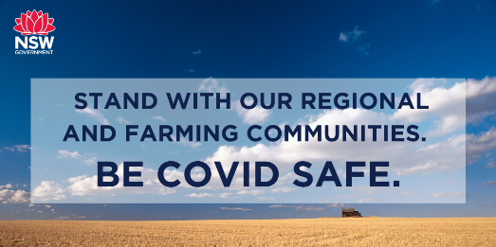
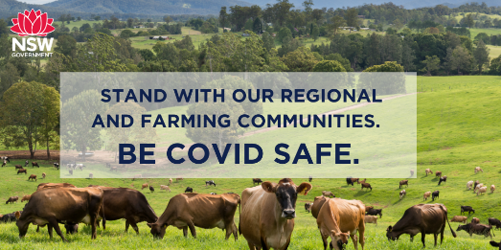
Social tiles

Slide 22
Social tiles

Slide 23
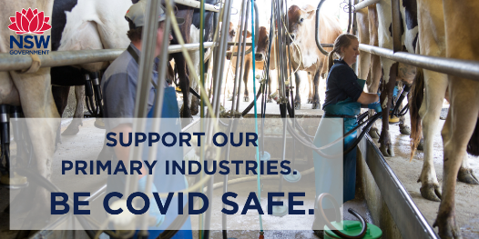
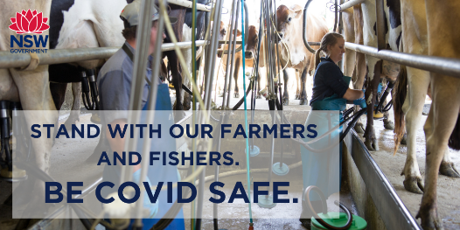
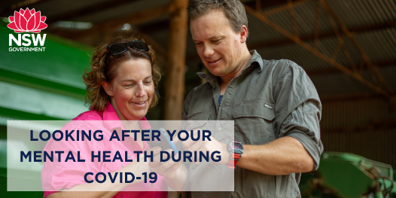
Social tiles

Slide 24
Workspace signage

Slide 25
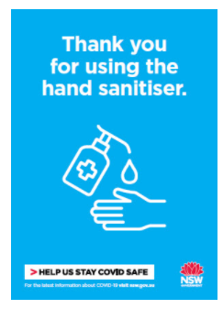
Workspace signage
Signage is useful to remind employees and customers of the steps they can take to stay safe.
A range of posters and signage is available in the COVID Safe toolkit
Link to resources

Slide 26
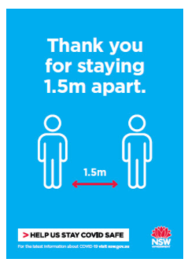
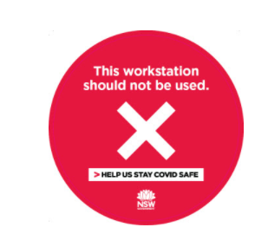
Workspace signage
Not all agri-businesses are on-farm.
Link to resources

Slide 27
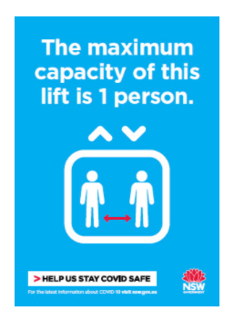
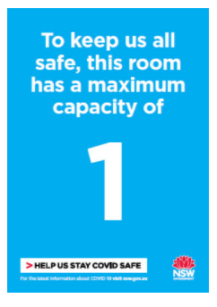
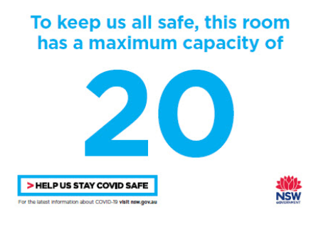
Workspace signage
Not all agri-businesses are on-farm.
Link to resources

Slide 28
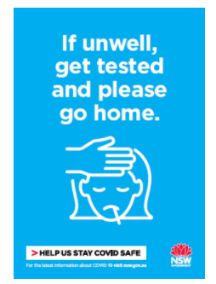
Workspace signage
Link to resources

Slide 29
Indigenous community content

Slide 30
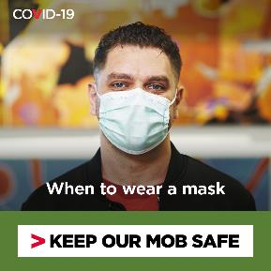
Indigenous community content: resources and guidance for staying COVID Safe
Keeping your mob COVID safe
To help protect the community from COVID-19:
Anyone with symptoms, even mild symptoms, should get tested. Visit a COVID-19 testing clinic or call your doctor or Aboriginal Medical Service to ask for a test
Stay a safe distance from others where possible - that means 1.5 metres or two big steps
Wear a mask when you can’t distance
If you're unwell, stay at home
Wash your hands often with soapy water or hand sanitiser.
COVID-19 testing
It only takes one person to spread COVID-19 in the community. Get tested, even if you only have one symptom, and self-isolate immediately.
COVID-19 symptoms include fever, coughing, sore or scratchy throat, shortness of breath, runny nose and loss of smell or taste.
You only need one symptom to get tested, and it can be mild. You might think it’s a cold or the flu but it could be COVID-19, and you can’t tell without a test.
Testing is safe – all staff wear protective gear and you will have a safe place to wait.
Testing is free at a public testing clinic. You don’t need a Medicare card. You can find your nearest testing clinic at nsw.gov.au or contact your doctor of Aboriginal medical service.
When to wear a mask
To protect yourself and your mob, you should wear a face mask if you:
can’t stay two big steps away from people
have symptoms and are going to get tested
are in isolation in the same room as another person
NSW Health strongly recommends people wear a mask when unable to physically distance, particularly on public transport and in other indoor settings, to keep everyone safe. Do not use public transport if you are unwell - stay home and get tested immediately.

Slide 31
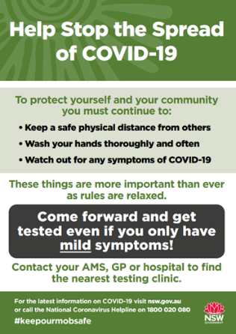
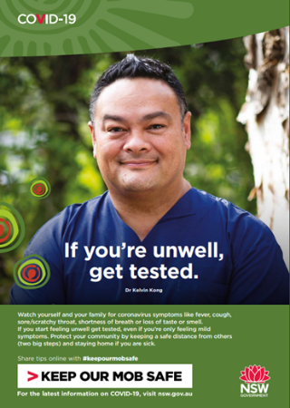
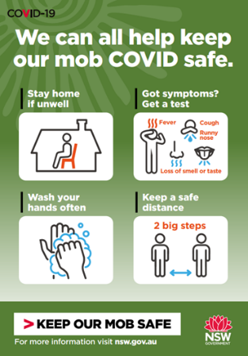
Indigenous community content
Link to download
Link to download
Link to download

Slide 32
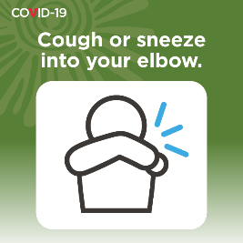
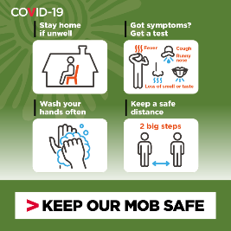
Social tiles: aboriginal communities
More aboriginal community resources available here

